Slide 1
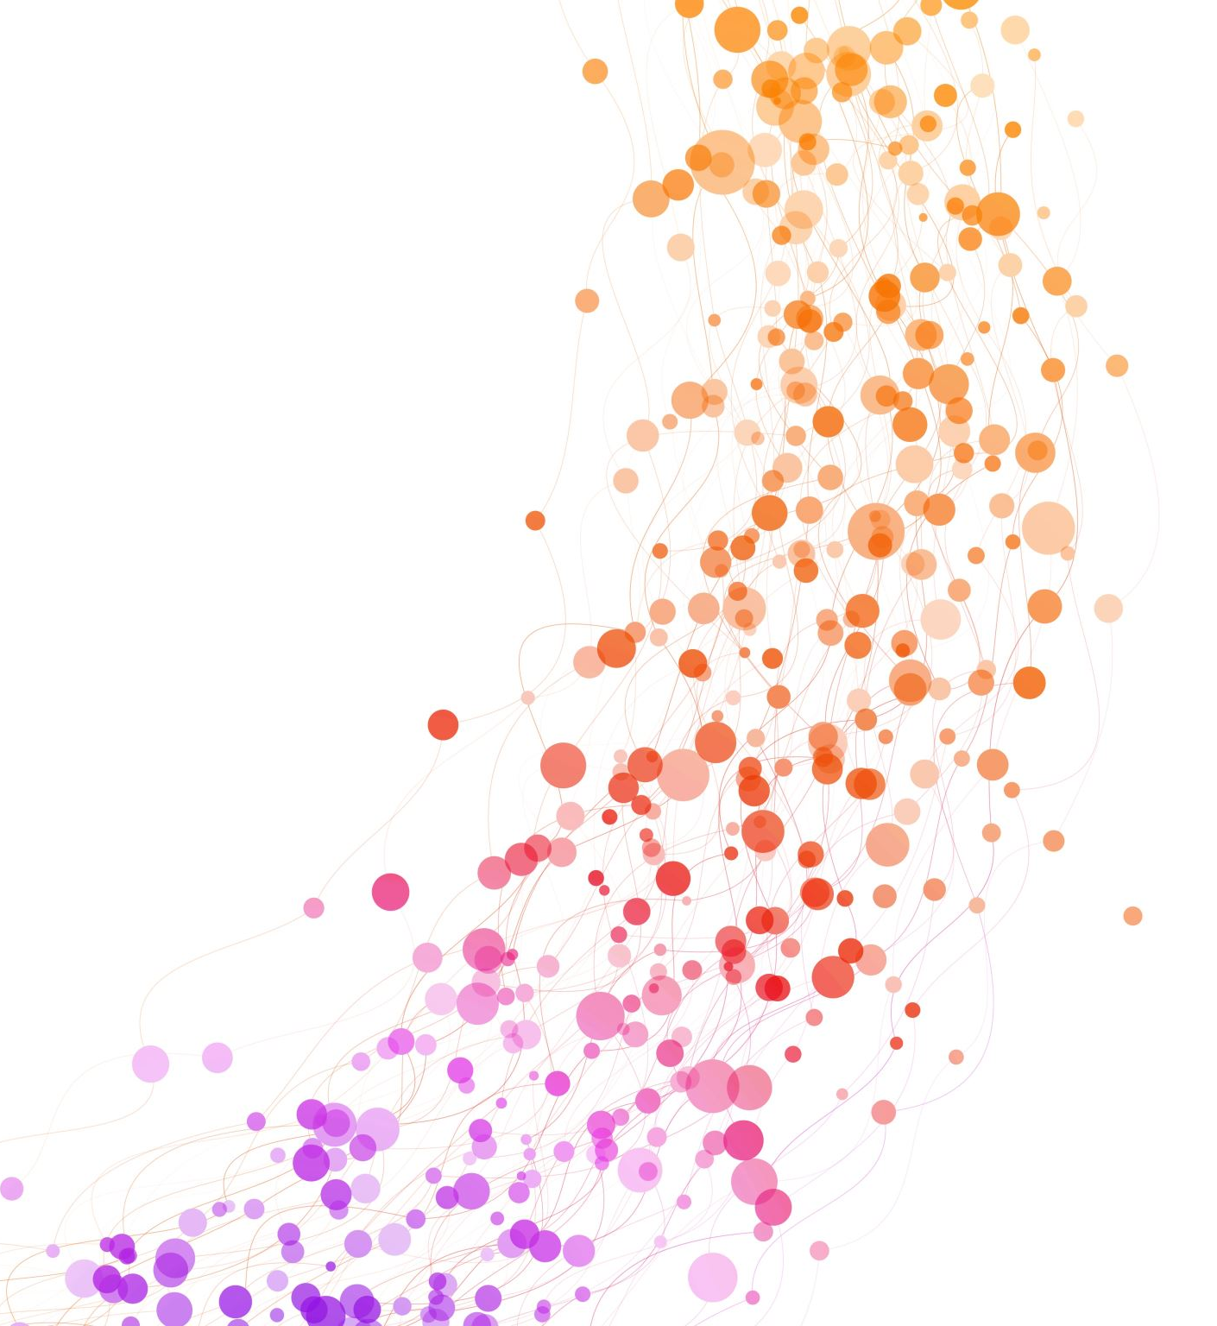
Clinical Case Presentation 1
Peter-William L. Myers

Slide 2
Objective Data
30 years old
CIS Male
Single and Heterosexual
African American
Biological Parents
5 siblings ranging between ages 18 and 27
High School Diploma and Medical Assistant Certificate
Wants to continue education but unsure of goals
Currently unemployed
Incarcerated 3x times between 18-19 years old; total of 8 months
Charges: Drug and weapon related, Dealing stolen property, and Grand Theft.
Suspended drivers license related to unpaid tickets and fines
Recent disclosure of SA history

Slide 3
Presenting problems: Client admitted for mental health track
F10.230 Alcohol dependence with withdrawal, uncomplicated
F25.0 Schizoaffective disorder, bipolar type
F17.200 Nicotine dependence, unspecified, uncomplicated
F11.20 Opioid dependence, uncomplicated
F60.3 Borderline personality disorder
F43.10 Post-traumatic stress disorder, unspecified
F14.20 Cocaine use disorder, Moderate
F16.10 Other hallucinogen use disorder, Mild

Slide 4
Symptoms
The client reports a significant decline in mental health, describing worsening depression, passive thoughts of wanting to be in treatment, urges to cut, poor sleep, loss of interest in previously enjoyed activities, decreased appetite, and reduced self-care, including not showering unless forcing himself. The client stated that his mental health decline contributed to relapse, and he sought admission to stabilize symptoms and address substance use before his condition worsened further. Client mistrust in people but wants to be helpful-he is tired of being hurt. He reported it might be better to isolate. Client struggles with developing and maintaining relationships.

Slide 5
Case Conceptualization
Narrative Therapy:
Client often sees himself through a deficit-based story. He consistently makes statements such as “I always mess things up,” “I don’t know how to connect with others,” and “I can’t trust others.”
Interventions:
Externalizing the Problem:
Teaching the client how to move from something he is to something that visits him
Rewriting the story:
Assisting client in rewriting inherited beliefs about what it means to be a man, emotional expressions, and worthiness.
Therapeutic Goals:
Teaching client how to respond to negative events with grounding instead of a negative story
Identifying values instead of inherited expectations
Helping him write a story of resilience, adaptability, trust, and growth

Slide 6
Case conceptualization
Attachment Theory:
Client presents with anxious/disorganized attachment evident by:
fear of disappointing others
Struggles with figuring out emotional needs
Hypervigilance during conflict
Engages in self-criticism following opening up/expressing emotions
Therapeutic Goal:
Assist client in creating secure attachments by modeling, teaching self-soothing, emotional intelligence, and creating a compassionate internal dialogue with self.

Slide 7
Recording

Slide 8
Leadership and advocacy
Client-Centered Advocacy:
Protecting the continuity of care by challenging systematic decisions that harm clients of color
Presenting the client narrative to staff in a way that is humanizing, focusing on strengths, possible progress, and barriers clients face created by culture and systematic inequities
Teaching staff about cultural humility to better understand the client’s reactions, communication, and overall being related/influenced by racial identity and mistrust of systems/people due to historical harms.
Notes:
INDIVIDUAL Level

Slide 9
Leadership and advocacy
Empowering the Client’s Voice:
Being a voice for the client for their experiences, needs, and concerns.
Modeling and supporting self-advocacy
Trauma-Informed Cultural Responsiveness:
Offering to staff how racial trauma, microaggressions, and cultural misunderstandings may present as client behaviors being misinterpreted.
Reframing the struggle as a need for support; not punishment.
Notes:
Individual Level

Slide 10
Leadership and advocacy
Modeling Couragous Conversations:
Name the patterns identified
Challenging staff assumptions
Being an advocate even when it is uncomfortable
Looking for Disparities and Trends:
Taking clear evidence that client’s of color may be more commonly threatened with administrative discharge and/or labeled as non-compliant.
Notes:
System/Program Level

Slide 11
Leadership and advocacy
Advocating for Policy Review and Reform:
Recommendation for creating and/or revising policies to ensure that we are not disproportionately harming cultural groups.
Including Cultural and Social Justice Standards:
Adding the ACA multicultural and social justice counseling competencies (MSJCC) into our organizational polices
Notes:
Examples:
Revisions to the administrative discharge criteria
Policies that require equity reviews
Policies that mandate cultural humility training before approving high-impact decisions

Slide 12
Comments and concerns
What strategies can I use to address patterns of potential bias or inequity within my treatment team without creating defensiveness or conflict among staff?
How can I continue supporting this client’s therapeutic progress while balancing clear program expectations—ensuring he is neither disproportionately penalized due to cultural or racial misunderstandings nor inadvertently allowed to bypass necessary boundaries or accountability?

