Slide 1
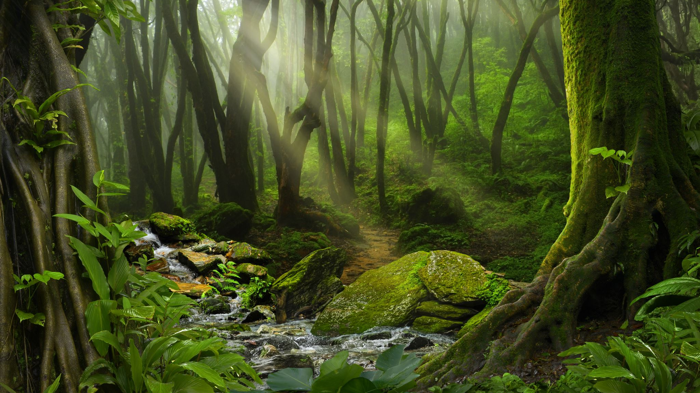
Nature-Informed Therapy
Using Nature as Co-Therapist in Substance Disorder Counseling

Slide 2
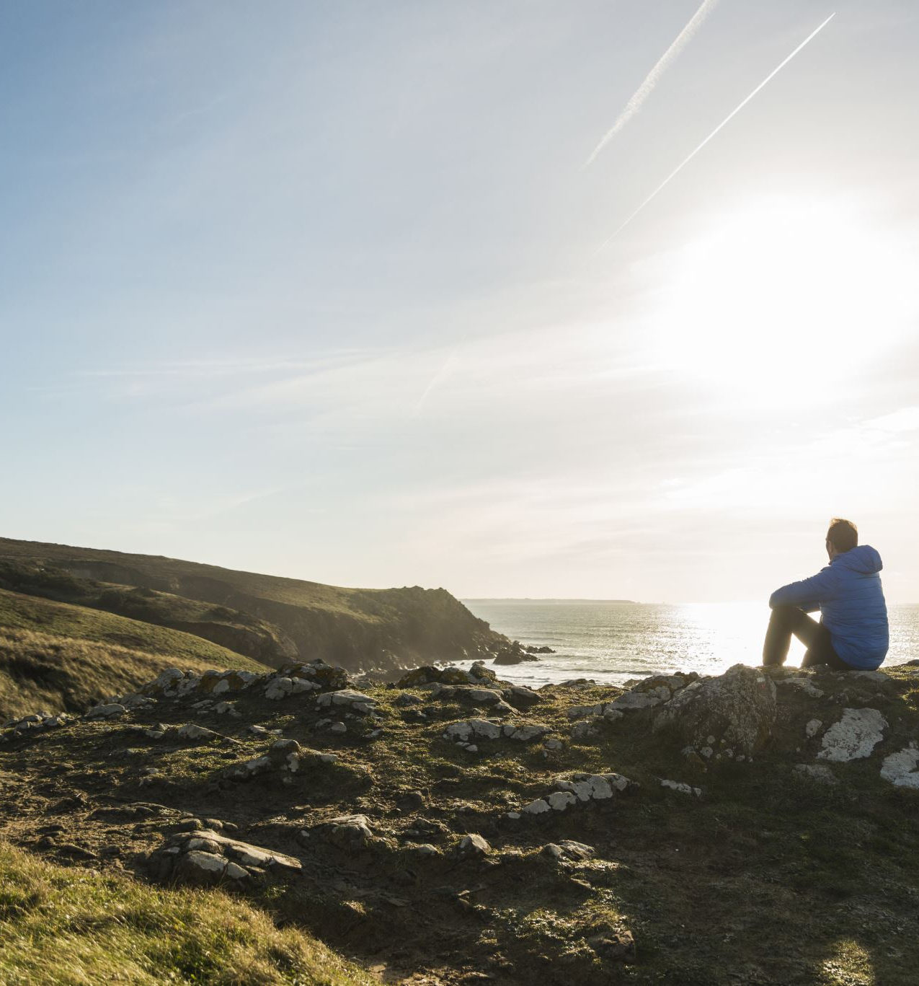
Reflection on pre-learning activity
Which activity did you pick for your pre-learning activity and why, how did you feel before, during, and after. How did this impact your mood, thoughts, or overall being? Now, imagine how this experience could be used in therapy for individuals struggling with substance use disorder.

Slide 3
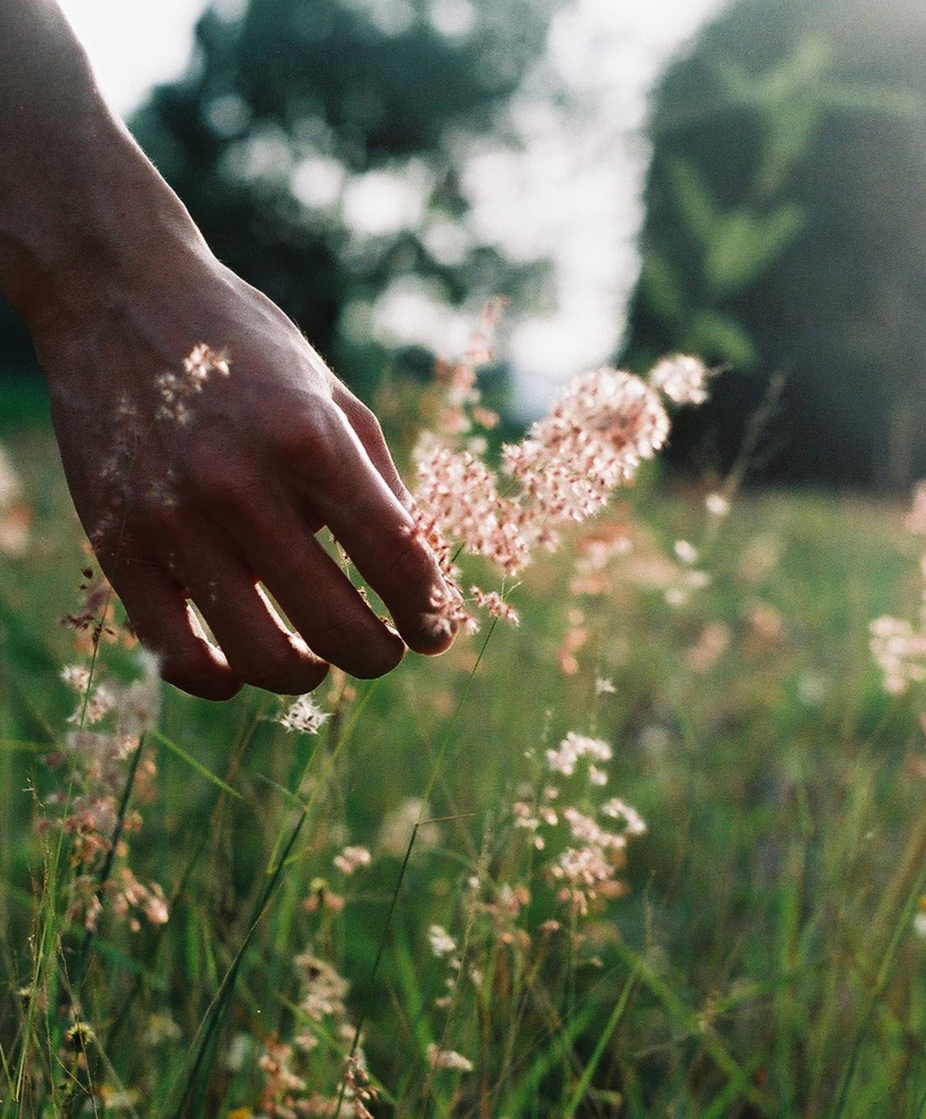
What is nature-informed therapy?
Using nature as a co-therapist
Reconnecting with nature to heal the wounds from disconnect
Rewilding and having a relationship with nature based on reciprocity
Stepping outside of oneself to experience awe moments
Finding Gratitude for life and our landscape to connect with a purpose

Slide 4
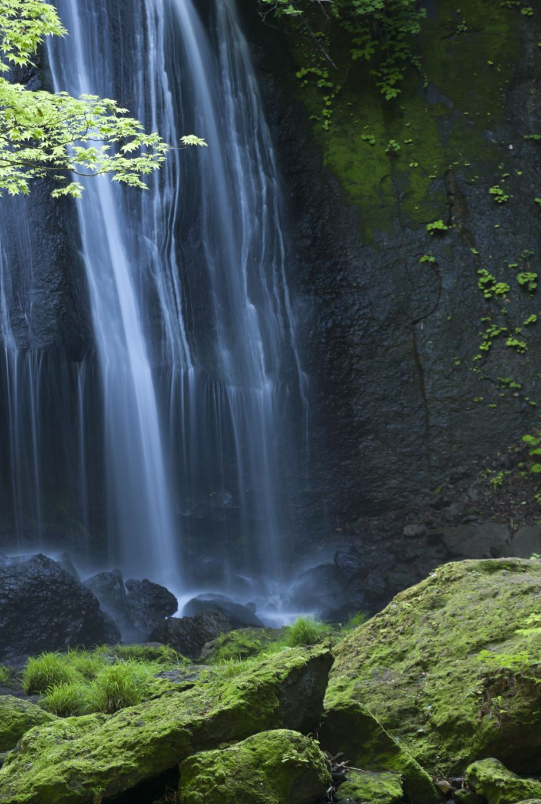
Where did nature-informed therapy come from?
Early Foundation: 19th century German priest Sabastian Kneipp pioneered what is known as hydrotherapy- a treatment approach that combines water applications. He would focus on the healing powers of natural elements.
In 1982, the Japanese Ministry of Agriculture, Forestry, and Fisheries introduced ”Shinrin Yoku” also known as forest bathing to promote the health benefits of nature. To this day, doctors in Japan will provide a prescription for forest bathing.
In the 1990s, Ecotherapy emerged showcasing a growing awareness of the nature-human connection impact on mental health and well-being.
There are many pathways and programs available to therapist and other professionals alike to receive an education on how to incorporate nature into everyday life to improve well-being.

Slide 5
What does nature-informed therapy look like?
Individual Sessions
Therapy sessions in natural environments such as walking in a park, sitting by a body of water, hiking, and sitting with a tree.
Telehealth Session
Nature Informed interventions such as nature videos, sitting outside in a green space, and nature based guided meditations.
Group Therapy
Psychotherapy and immersive groups outdoors such as grief and loss groups, connecting to the natural world through camping/excursions and community group hiking

Slide 6
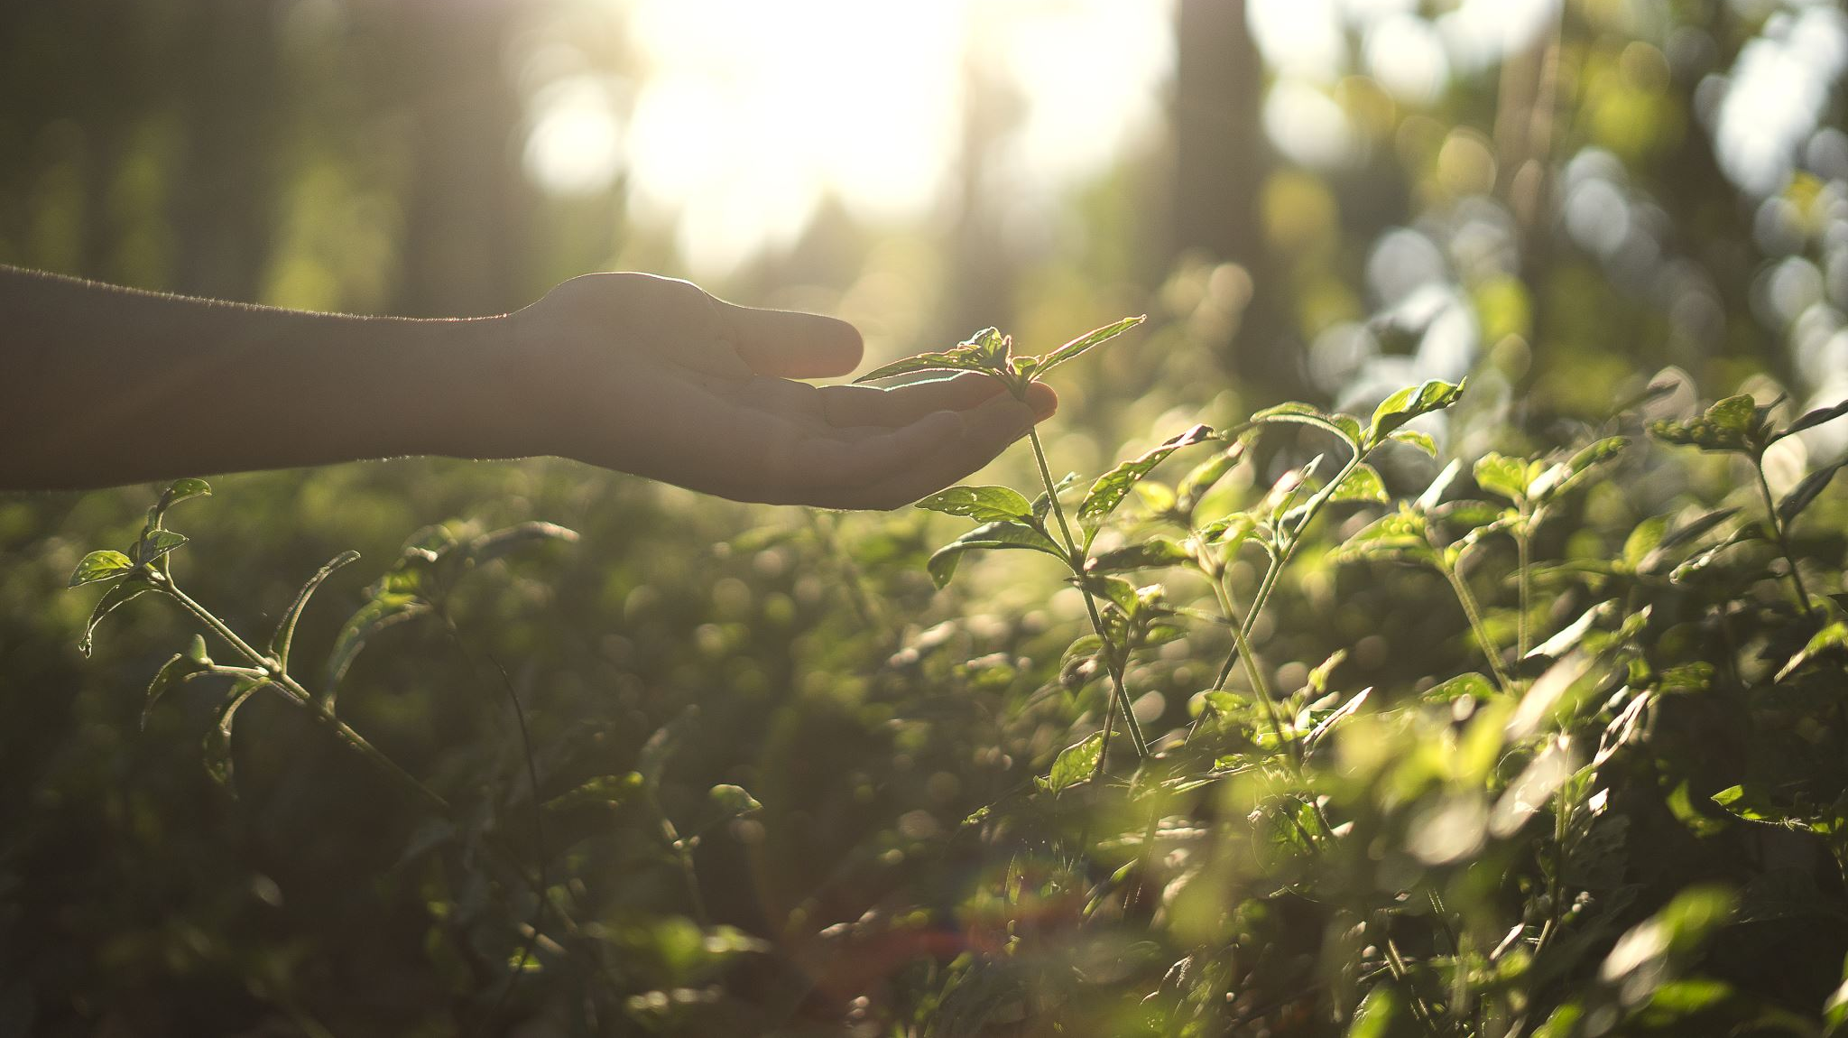
Nature-Informed therapy interventions
Sitspot
Finding a place to sit and observe nature. Writing down what you observe as you sit quietly.
Sitting with a tree
Walking among the trees and finding a tree to sit with. Identify why you felt connection to this tree.
Guided meditations
Using nature visualizations during guided meditations such as leaves on the stream
Mindful Practices
These practices take us off autopilot, allows us to pause, experience the present moment, and give gratitude.
Grounding/Earthing
Standing/walking barefoot on natural ground. Earthing allows us to directly connect our body to the earth and use its natural charges to stabilize us.
Inner Child Work
Working to heal the inner child using nature.
Shifting Perspectives
Changing an individual’s perspective to see a problem in a new way.

Slide 7
Disconnect Vs Connected
Disconnect
Most kids and adults can name over 5 apps but cannot name a tree in their own yard.
Humans went from spending 90 percent of time outdoors to spending minimal time in nature, most areas are urban and developed.
This has in exchange negatively impacted mental, emotional, and physical health.
Connected
Decrease loneliness, anxiety, and depression.
Improved mental health and physical health
Feel a sense of belonging
Create our tribe
Authentic self
Freedom

Slide 8

Nature RX Video
Nature Rx

Slide 9

Break out rooms for case studies for Nature-Informed Therapy intervention
Time to give NIT a try
We will discuss how to implement Nature-Formed Therapy inventions into a treatment plan based off the case study.
We will come back and share the ideas with the larger group.

Slide 10
Closing our class on Nature-Informed Therapy
What is one new thing you learned tonight?
Questions, comments, or concerns (open discussion)

Slide 11
References
Joschko, L., Pálsdóttir, A. M., Grahn, P., & Hinse, M. (2023). Nature-based therapy in individuals with mental health disorders, with a focus on mental well-being and connectedness to nature—a pilot study. International Journal of Environmental Research and Public Health, 20(3), 2167. https://doi.org/10.3390/ijerph20032167 Teerapong, T., Arin, N., & Weinstein, B. (2024). Connectedness to nature and psychological well-being among Thai Buddhists. Mental Health, Religion & Culture, 27(1), 44–56. https://doi.org/10.1080/13674676.2023.2245762 Davies, S. (2024). Walking and talking. Healthcare Counselling & Psychotherapy Journal, 24(4), 8–13.

